Slide 1
E-commerce
3
Syed Asim Jalal
Department of Computer Science
University of Peshawar

Slide 2
Buyer aggregator model
The buyer aggregator brings together large numbers of individual buyers so that they can gain the types of savings that are usually the privilege of large volume buyers.
  Mercata (www.mercata.com) was the first American company to receive a patent for group buying over the internet (Business Wire, 2000).
  Mercata, the first-movers as buyer aggregators, failed to sustain initial customer interest and folded after only two years
  Brokers who organise the collective bargaining of buyers in this way gain revenue by charging the seller a percentage of each sale made to the group of buyers.
  this e-business model has had limited success because most firms have been unable to achieve a critical mass of customers

Slide 3
Classifieds
Online classified advertisements run on the same principles as newspaper classifieds.
Content providers list items for sale by sellers and purchases wanted by buyers. Revenue is gained by listing charges and is collected whether or not a transaction takes place.
Example:
  OLX, gumtree.com, craiglist.com

Slide 4
Infomediaries
Infomediaries specialise in gathering valuable information about customers and selling it on to third parties. These third parties analyse the data and use it to support marketing campaigns.
The simplest form of gathering data is through requiring users to register for access to free-to-view content sites. This facilitates the monitoring of user’s site viewing patterns and the data generated can then be used for a more targeted marketing campaign.
Infomediaries may offer incentives to customers to disclose information about their profile and buying habits. These may take the form of free software or hardware or free internet access for a specified time period.
There can be more complex forms of getting users’ data behaviour online and then selling it.
  “sharing data with business partners”

Slide 5
E-procurement
The internet provides the mechanism for businesses to procure the raw materials they need to create outputs and to help run their businesses efficiently.
E-procurement is the management of all procurement activities via electronic means.
Business models based on e-procurement seek efficiency in accessing information on suppliers, availability, price, quality and delivery times as well as cost savings by collaborating with partners to pool their buying power and secure best value deals.

Slide 6
Car manufacturer Ford developed an online B2B exchange that specialises in e-procurement of supplies for a consortium of US car manufacturers that includes Ford, Daimler-Chrysler and GM.
This e-procurement infomediary, called ‘Covisint’, provides information on the many thousands of potential suppliers of component parts for the car industry and uses the huge purchasing power of the consortium to gain best value deals.

Slide 7
Online Entertainment
Online entertainment means providing access to online entertainment contents. The entertainment contents could be video, audio or games.
  Video on demand (VOD) service
    Video on demand service provides access to large number videos
    Users can access any video anytime by their own choice unlike a broadcast TV.
    Movies or TV shows are recorded and made available
    For example: Netflix, iTunes.

Slide 8
  Online Music services
    spotify
  Online Live TV channels
    These services provide access to live TV channels.
    Some can be free and some can charge fees
  Online Gaming
    These services allow you to play online games
    Online multiplayer games are very popular
Different revenue models can be applied in online entertainment businesses.
    Subscription model. Pay fees for some limited time duration, for All-You-Can-Watch!
    Pay as you go or pay-per-view pricing

Slide 9
Buy Now Pay Later model
This model is based on buying using credit (loan)
The payment can start up to 6 months after purchase of goods
Like any other credit (e.g. credit cards) customer has to pay interest on the amount
Customer credit (loan) history is checked for eligibility
The credit is actually arranged by the company from a credit provider (banks)
Paying later encourages many customer to buy products.

Slide 10
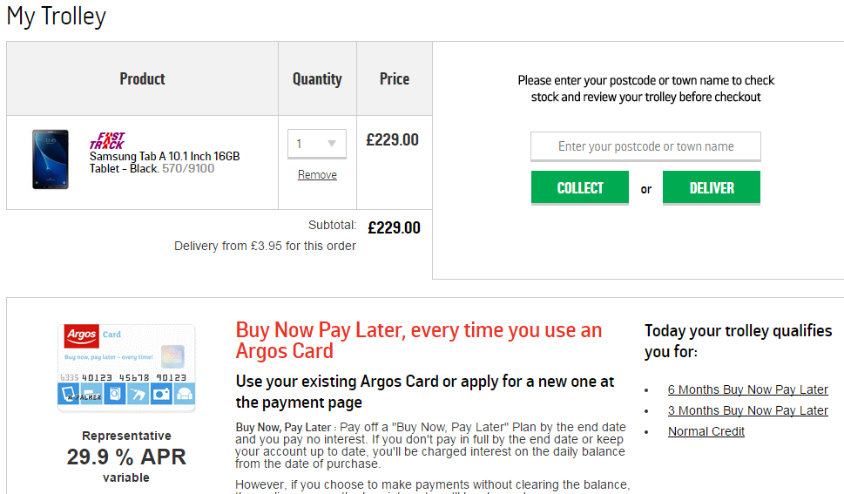

Slide 11
Comparison Model
Many online companies provides opportunities for customers to compare different products and their pricing.
Such websites can help users making savings as well as help them to make informed choices about products of their choice.
  Products and price comparison
  Insurance comparison
  Energy services comparison
www.moneysupermarket.com
www.mysupermarket.com

Slide 12
Online Service Providers
Many companies provides variety of online services. for example.
Cloud based software
  Evernote, Microsoft 365, Mendeley
Online Graphics tools
Cloud Data Storages
  Dropbox, sugarsync
Online Proof-Reading and Editing services
Online Marketing Services
etc.

Slide 13
Social Networking Applications
Online Social networking systems use websites and applications that allow users to interact with other users, or to find people with similar interests.
They generate income from mostly advertisement and sharing users’ interests/ behaviour /data with other companies.
  A social network can be a general purpose or for a specific purpose
  Users’ activity or preferences on social network provide a good opportunity for targeted advertisement.
    Facebook, Instagram, linkedin, etc

Slide 14
Deals Websites
Many websites lists latest deals or offers on different products or services by different companies
These websites are updated regularly either automatically or by registered users or by companies themselves.
These website generates huge traffic and income could comes from advertisements or commissions from affiliate companies when customer are referred to their companies and they make purchases.
  Groupon.com
  UKHOTDEALs.co.uk

Slide 15
Collaboration platforms
Collaboration between organisations is a key feature of the modern business environment and the internet can play a role in the communication between partner organisations.
Collaboration platforms provide the technological tools for information to pass quickly and efficiently between organisations.
Information is shared for various purposes. For example, sharing customer information for joint marketing ventures or logistics for the tracking of supplies.

Slide 16
Third-party marketplaces
Some firms specialise in using the internet to market and promote products and services on behalf of client organisations.
These client organisations may have experience of marketing and selling products through traditional channels but lack the specific expertise and experience to transfer this knowledge to the e-business environment.
A third-party marketplace is a channel through which firms can extend their sales pitch to customers by making available their product catalogue on the website. The entire transaction process can be undertaken through the third-party marketplace since most include applications for ordering, distribution and payment.

Slide 17
Third-party marketplaces vs E-malls
  All shops in e-malls have some commonality between them. For example they all may sell similar products or offer similar services.

Slide 18
Other e-business models
Online news
Online banking
Tourism services
Online real estate agency
Online job agency

